Slide 1
Why Do we need Container Orchestration?

Slide 2
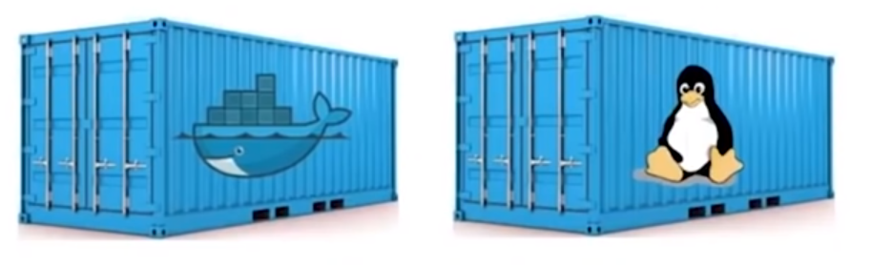
Containers are Good…
Both Linux Containers and Docker Containers
Isolate the application from the host
FASTER, RELIABLE, EFFICIENT, LIGHTWEIGHT, AND SCALABLE

Slide 3
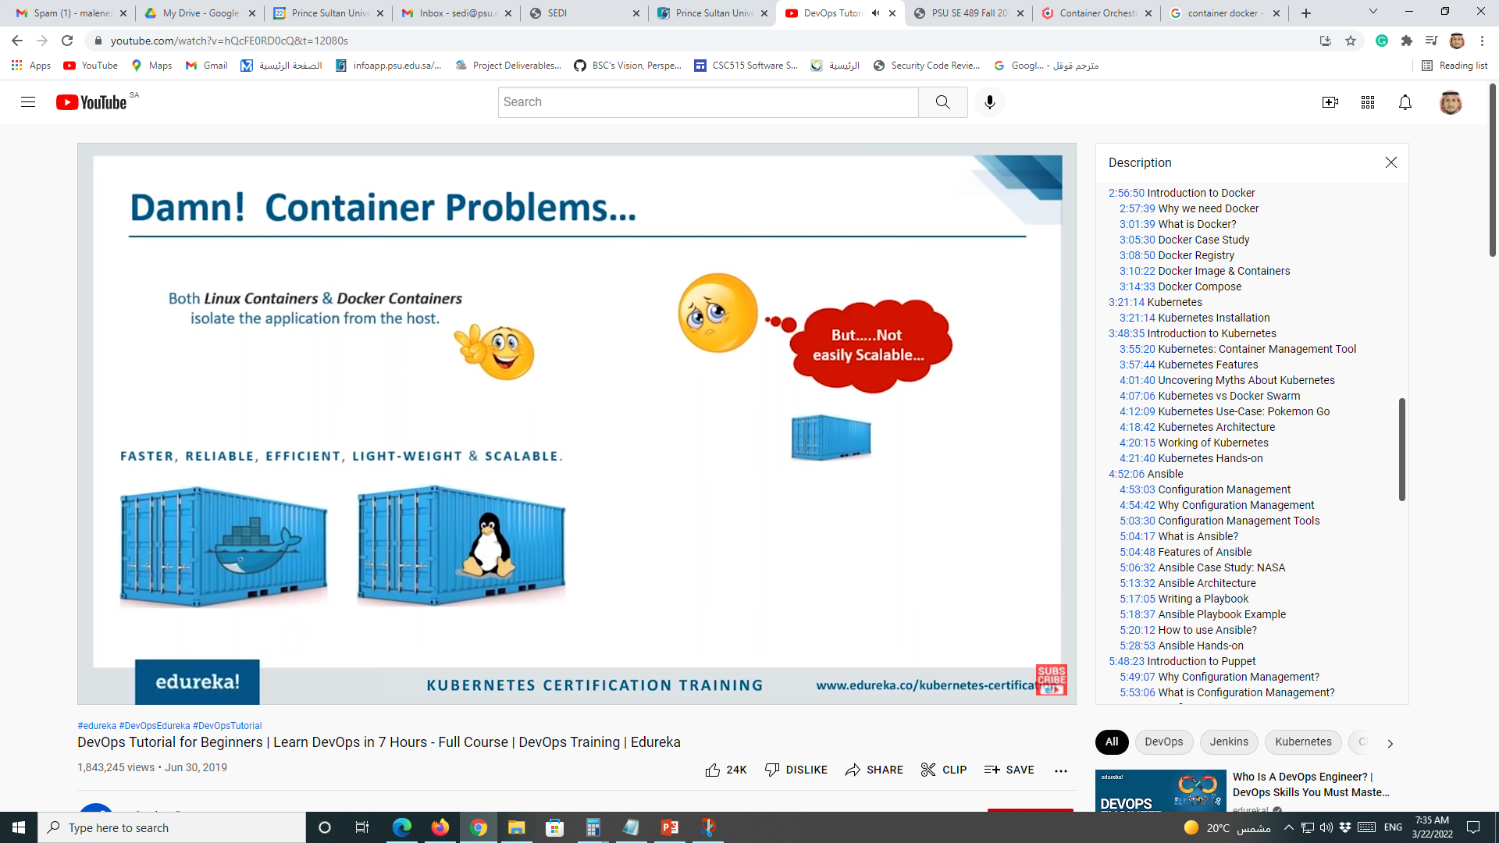
Containers Problems!
Both Linux Containers and Docker Containers
Isolate the application from the host
Not easily Scalable
FASTER, RELIABLE, EFFICIENT, LIGHTWEIGHT, AND SCALABLE

Slide 4
Containers Problems!
Both Linux Containers and Docker Containers
Isolate the application from the host
Not easily Scalable
FASTER, RELIABLE, EFFICIENT, LIGHTWEIGHT, AND SCALABLE

Slide 5
Problems with Scaling up Containers
Containers could communicate with each other
Containers had to be deployed appropriately
Containers had to be managed carefully
Auto scaling was not possible
Distributing traffic was still challenging
It was not Scalable
1
2
3
4
5

Slide 6
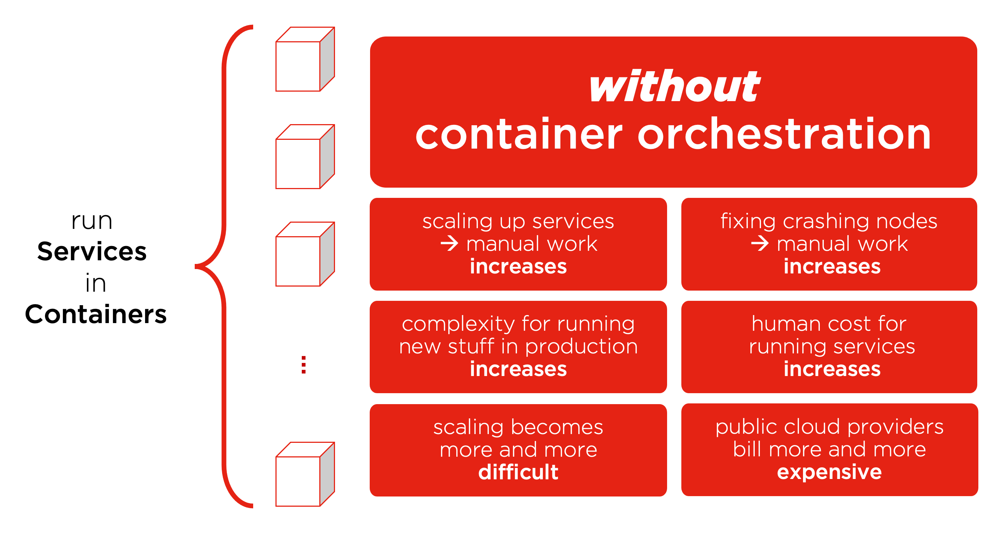
Containers Without Orchestration

Slide 7
Why do we need container orchestration?
Because containers are lightweight and ephemeral by nature, running them in production can quickly become a massive effort.
Particularly when paired with microservices—which typically each run in their own containers—a containerized application might translate into operating hundreds or thousands of containers, especially when building and operating any large-scale system.
This can introduce significant complexity if managed manually.
Container orchestration is what makes that operational complexity manageable for development and operations—or DevOps—because it provides a declarative way of automating much of the work.

Slide 8
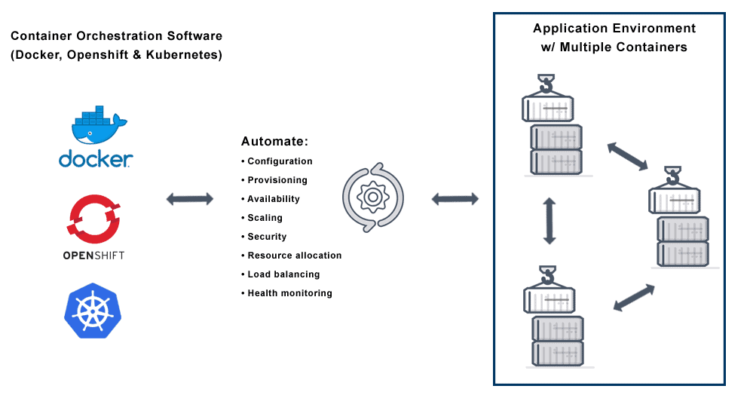
Container Orchestration

Slide 9
What are the benefits of container orchestration?
Container orchestration is key to working with containers, and it allows organizations to unlock their full benefits. It also offers its own benefits for a containerized environment, including:
Simplified operations
Most important benefit of container orchestration and the main reason for its adoption.
Manages the complexity of Containers
Resilience
Automatically restart or scale a container or cluster, boosting resilience.
Added security
Keeping containerized applications secure by reducing or eliminating the chance of human error.

Slide 10
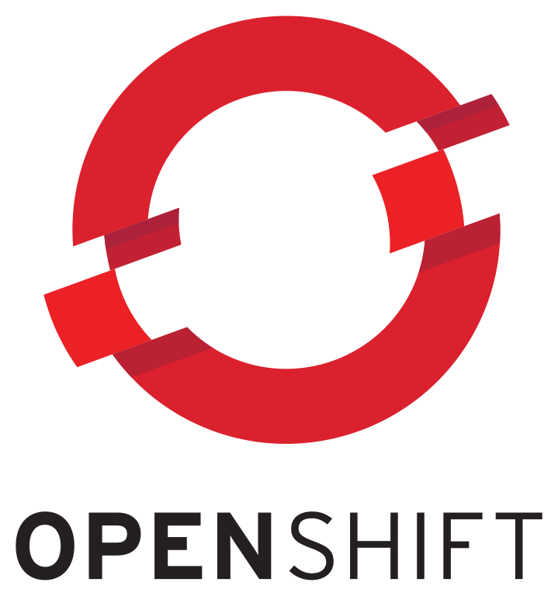
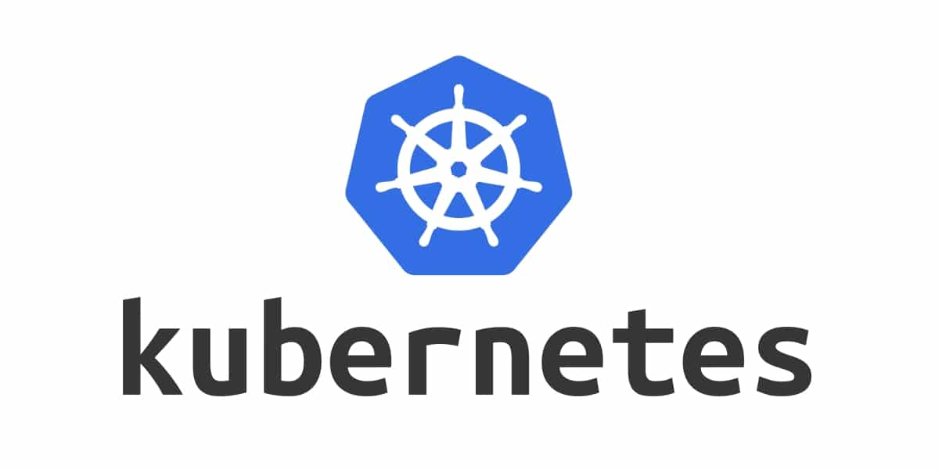
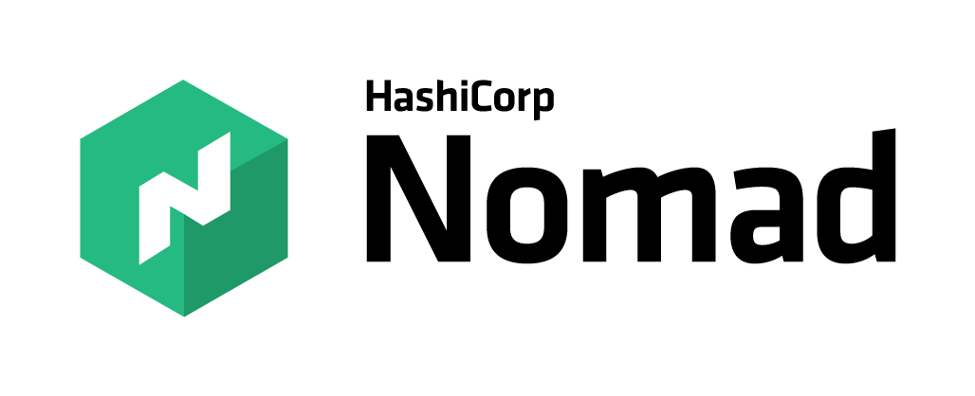
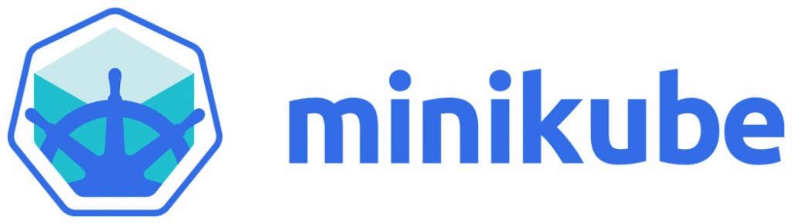

Container Orchestration Tools

Slide 11
What is Kubernetes and How it works

Slide 12
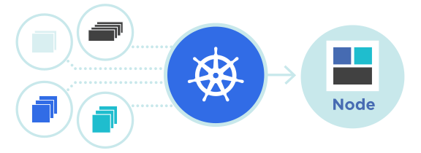
Kubernetes
Kubernetes is an open-source container management tool which automates container deployment, container (de)scaling and container load balancing
Benefits (Works with all cloud vendors (Public, Private (on-premises), and Hybrid))
More about Kubernetes
Developed by Google and written in Golang with a huge community
Can group ‘n’ containers into one logical unit for managing and deploying them

Slide 13
Kubernetes
Kubernetes is an open source container orchestration engine for automating deployment, scaling, and management of containerized application.
Originally an open source project launched by Google and now part of the Cloud Native Computing Foundation (CNCF).
Kubernetes is highly extensible and portable
Kubernetes is considered highly declarative
Kubernetes initial release (7 June 2014)
Releases every 3 months

Slide 14
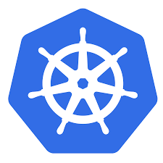
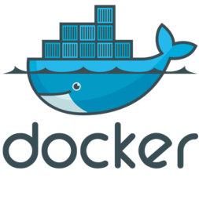

Kubernetes
Node
Node
Node
Cluster

Slide 15
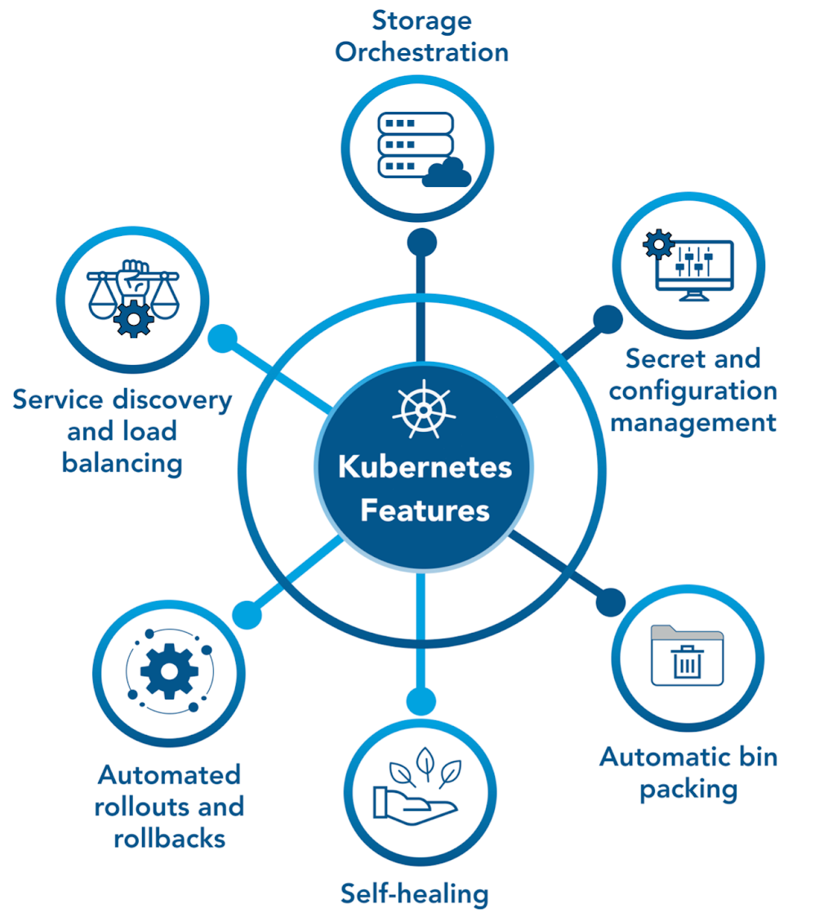
Kubernetes Features

Slide 16
Kubernetes Myths
Kubernetes is not:
To be compared with Docker
For containerizing apps
For apps with simple architecture
Kubernetes is actually:
Robust and reliable
A container orchestration platform
A solution for scaling up Containers
Backed by huge community
X
√

Slide 17
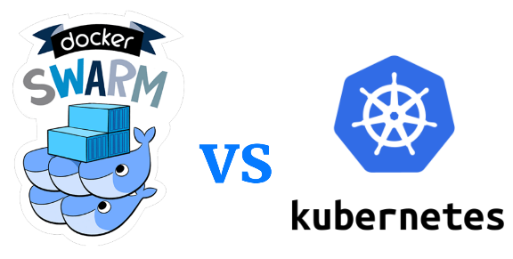
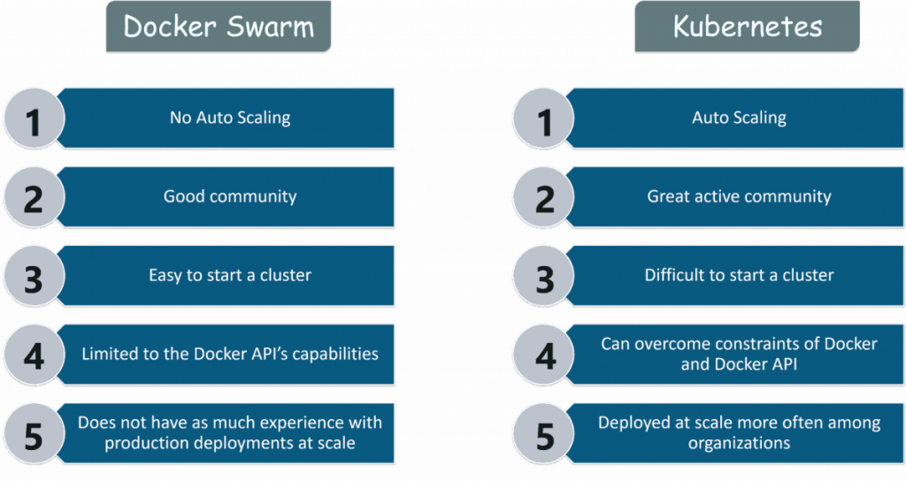
Kubernetes vs Docker Swarm

Slide 18
Kubernetes vs Docker Swarm
Features | Docker Swarm | Kubernetes
Installation and Cluster Configuration | Easy and Fast | Complicated and Time-consuming
GUI | Not Available | Available
Scalability | Scaling up is faster than K8S; but cluster strength is not as robust | Scaling up is slower but guarantees stronger cluster state
Load Balancing | Built-in load balancing technique | Requires manual service configuration
Updates and Rollback | Progressive updates and service health monitoring | Process scheduling to maintain services while updating
Data Volumes | Can be shared with any container | Only shared with containers in the same Pod
Logging and Monitoring | Only 3rd party logging and monitoring tools | Built-in logging and monitoring tools

Slide 19
Kubernetes Architecture

Slide 20
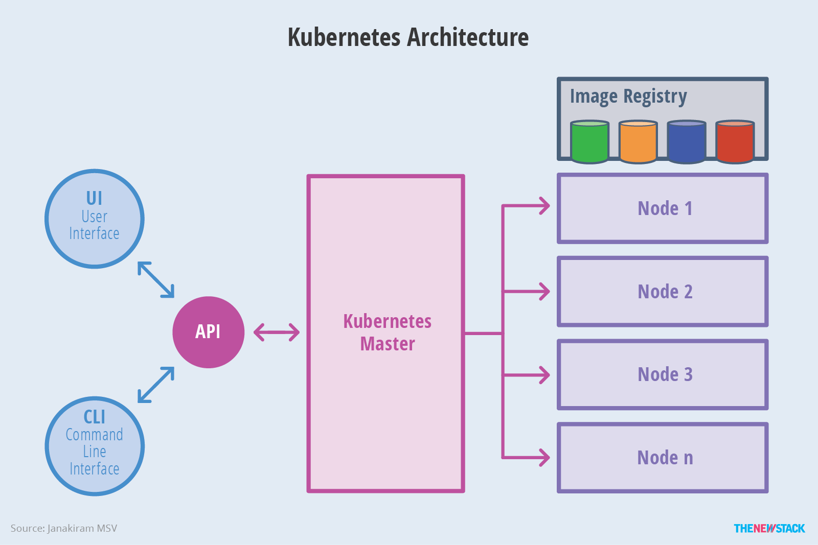
Kubernetes Architecture

Slide 21
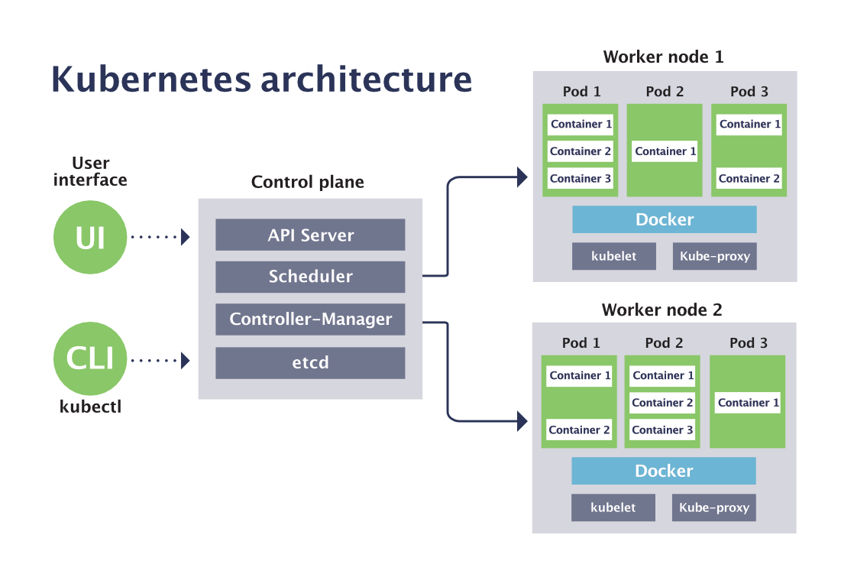
Kubernetes Architecture

Slide 22
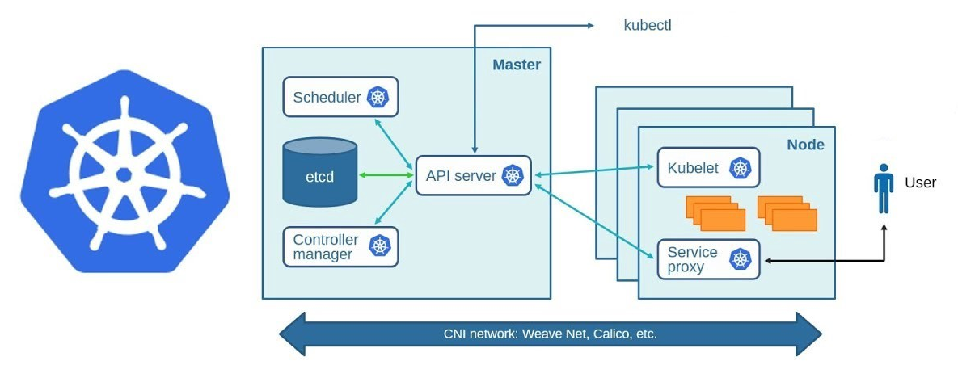
Kubernetes Architecture

Slide 23
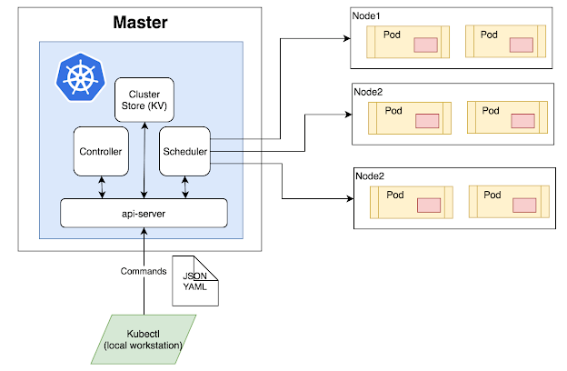
Kubernetes Components
Cluster:
A collection of hosts(servers) that aggregates their available resources.
Master:
A collection of components which make up the control panel of Kubernetes.
Node:
A single host which is capable of running on a physical or virtual machine.
Namespace:
A logical cluster or environment.

Slide 24
Kubernetes Components
When you deploy Kubernetes, you get a cluster.
A Kubernetes cluster consists of a set of worker machines, called nodes, that run containerized applications.
Every cluster has at least one worker node;
The worker node(s) host the Pods that are the components of the applications.
The master manages the worker nodes and the Pods in the cluster

Slide 25
Kubernetes Architecture
The master is responsible for:
exposing the Kubernetes (REST) API,
scheduling the applications,
managing the cluster,
directing communications across the entire system,
monitoring the containers running in each node as well as the health of all the registered nodes.
The nodes that are responsible for scheduling and running the containerized applications
Container images, which act as the deployable artifacts, must be available to the Kubernetes cluster through a private or public image registry.

Slide 26
Kubernetes Master
The Kubernetes master runs the following components that form the control plane:
API server: the front-end for the Kubernetes control plane that exposes the Kubernetes API
kube-apiserver
designed to scale horizontally
etcd: is a persistent, lightweight, distributed key-value data store that maintains the entire state of the cluster at any given point of time
scheduler: watches for newly created Pods with no assigned node, and selects a node for them to run on
kube-scheduler
controller: control loop that watches the shared state of the cluster through the apiserver and makes changes attempting to move the current cluster state to the desired cluster state

Slide 27
Kubernetes Nodes
Node components run on every node, maintaining running pods and providing the Kubernetes runtime environment.
Kubernetes Nodes components:
kubelet: agent that makes sure that containers are running in a Pod.
kube-proxy: implemented as a network proxy and a load balancer.
It routes traffic to the appropriate container based on its IP address and the port number of the incoming request.
Part of the Kubernetes Service concept.
container runtime: the software that is responsible for running containers.
Kubernetes supports several container runtimes:
Docker,
containerd,
CRI-O,
any implementation of the Kubernetes CRI (Container Runtime Interface).

Slide 28
Kubernetes Object
Kubernetes objects are persistent entities provided by Kubernetes for deploying, maintaining, and scaling applications.
Kubernetes uses these entities to represent the state of your cluster.
The objects can describe:
What containerized applications are running (and on which nodes)
The resources available to those applications
The policies around how those applications behave, such as restart policies, upgrades, and fault-tolerance
To work with Kubernetes objects (i.e., to create, modify, or delete them) you'll need to use the Kubernetes API. When you use the kubectl command-line interface, for example, the CLI makes the necessary Kubernetes API calls for you.

Slide 29
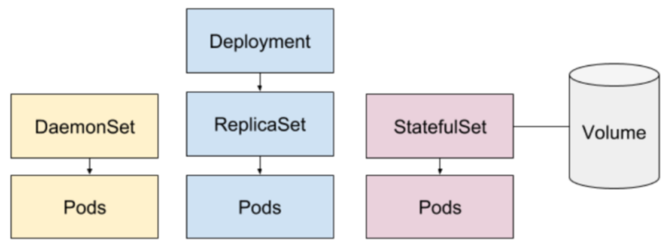
Basic Kubernetes Objects
Pod
Deployment, ReplicaSet
DaemonSet
StatefulSet
Service
Secret

Slide 30
Pods
Pods are the smallest deployable units of computing that you can create and manage in Kubernetes.
A Pod is a group of one or more containers, with shared storage/network resources, and a specification for how to run the containers.
A Pod's contents are always co-located and co-scheduled.
To create and manage multiple Pods, Kubernetes defines multiple resource types:
Deployment
StatefulSet
DaemonSet

Slide 31
Deployment
Deployment: represents a set of multiple, identical Pods with no unique identities.
It runs multiple replicas Pods and automatically replaces any instances that fail or become unresponsive.
Deployments ensure that one or more instances of Pods are available to serve user requests.
PodTemplates are specifications for creating Pods, and are included in resource objects such as Deployment object.
A ReplicaSet is the next-generation of ReplicationControllers
It ensures that a specified number of pod replicas are running at any given time.

Slide 32
Pod Management
StatefulSet: manages deployment and scaling of a set of Pods, with durable storage and persistent identifiers for each pod.
Unlike a Deployment, a StatefulSet maintains a sticky identity for each of its Pods.
DaemonSet: ensures that all (or some) nodes run a copy of a Pod.
As nodes are added to the cluster, Pods are added to them.
As nodes are removed from the cluster, those Pods are garbage collected.
Deleting a DaemonSet will clean up the Pods it created.

Slide 33
Controller
Controllers are control loops that watch the state of the cluster, then make or request changes where needed.
A controller tracks at least one Kubernetes resource object.
The controller(s) for that resource are responsible for making the current state come closer to that desired state (specified in the spec field).
Kubernetes comes with a set of controllers that run inside the kubecontroller-manager
The Deployment controller is an example of controller that come as part of Kubernetes itself ("built-in" controllers).

Slide 34
Service
The services model relies upon the most basic, though most important, aspect of services: discovery.
a Service is an abstraction which defines a logical set of Pods and a policy by which to access them.
The set of Pods targeted by a Service is usually determined by a selector.
Services ensure that traffic is always routed to the appropriate Pod within the cluster, regardless of the node on which it is scheduled.
Each service exposes an IP address, and may also expose a DNS endpoint, both of which will never change.
Internal or external consumers that need to communicate with a set of pods will use the service’s IP address, or its more generally known DNS endpoint.

Slide 35
Secret
Secrets are secure objects which store sensitive data, such as passwords, OAuth tokens, and SSH keys, in your clusters.
Storing sensitive data in Secrets is more secure than plaintext in Pod specifications.
Using Secrets gives you control over how sensitive data is used, and reduces the risk of exposing the data to unauthorized users.

Slide 36
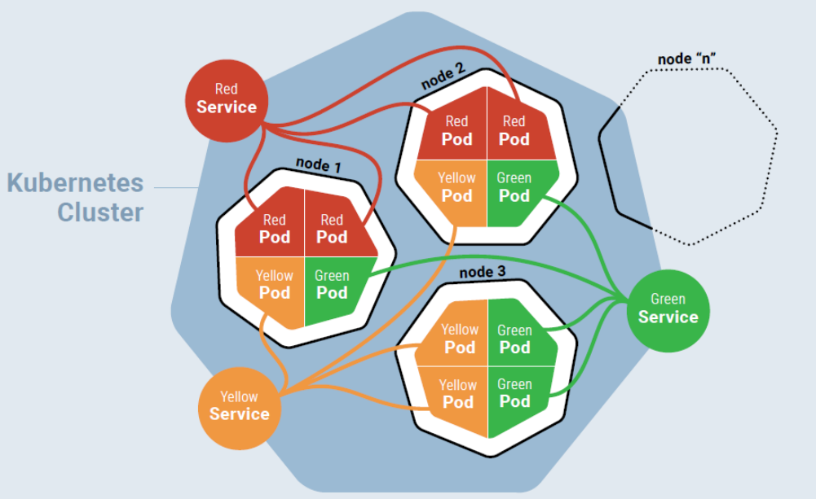
Kubernetes Cluster

Slide 37

Kubernetes - Advantages
There are many reasons why people come to use
containers and container APIs like Kubernetes:
Velocity
Scaling (of both software and teams)
Abstracting the infrastructure
Efficiency
All these aspects relate to each other to speed up process that can reliably deploy software.
k8s
API
<kube-service>
User

Slide 38
Kubernetes – Advantages - Velocity
Velocity is enabled by:
Immutable system: you can't change running container, but you create a new one and replace it in case of failure (allows for keeping track of the history and load older images)
K8s <nodes>
VM
<database>
VM
<model_v2.0>
VM
<frontend>
VM
<model_v1.0>

Slide 39
Kubernetes – Advantages - Velocity
Velocity is enabled by:
Declarative configuration: you can define the desired state of the system restating the previous declarative state to go back. Imperative configuration are defined by the execution of a series of instructions, but not the other way around.
K8s <nodes>
YAML
<app.yaml>
2 database
1 model
1 frontend
VM
<database>
VM
<database>
VM
<model_v1.0>
VM
<frontend>

Slide 40
Kubernetes – Advantages - Velocity
Velocity is enabled by:
Online self-healing systems: k8s takes actions to ensure that the current state matches the desired state (as opposed to an operator enacting the repair)
K8s <nodes>
YAML
<app.yaml>
2 database
1 model
1 frontend
VM
<database>
VM
<database>
VM
<model_v2.0>
VM
<frontend>
VM
< database >

Slide 41
Kubernetes – Advantages - Scaling
Kubernetes provides numerous advantages to address scaling:
Decoupled architectures: each component is separated from other components by defined APIs and service load balancers.
Easy scaling for applications and clusters: simply changing a number in a configuration file, k8s takes care of the rest (part of declarative).
Scaling development teams with microservices: small team is responsible for the design and delivery of a service that is consumed by other small teams.

Slide 42
Kubernetes – Advantages - Scaling
Kubernetes provides numerous abstractions and APIs that help building these decoupled microservice architectures:
Pods can group together container images developed by different teams into a single deployable unit (similar to docker-compose)
Other services to isolate one microservice from another such (e.g. load balancing, naming, and discovery)
Namespaces control the interaction among services
Ingress combine multiple microservices into a single externalized API (easy-to-use frontend)
K8s provides full spectrum of solutions between doing it “the hard way” and a fully managed service

Slide 43
Kubernetes – Advantages - Abstraction
Kubernetes allows to build, deploy, and manage your application in a way that is portable across a wide variety of environments.
The move to application-oriented container APIs like Kubernetes has two concrete benefits:
separation: developers from specific machines
portability: simply a matter of sending the declarative config to a new cluster

Slide 44
Kubernetes – Advantages - Efficiency
There are concrete economic benefit to the abstraction because tasks from multiple users can be packed tightly onto fewer machines:
Consume less energy (ratio of the useful to the total amount)
Limit costs of running a server (power usage, cooling requirements, datacenter space, and raw compute power)
Create quickly a developer’s test environment as a set of containers
Reduce cost of development instances in your stack, liberating resources to develop others that were cost-prohibitive

Slide 45
Kubernetes - Advantages
Easy organization of service with pods
Largest community among container orchestration tools
Kubernetes can run on-premises bare metal, OpenStack, public clouds Google, Azure, AWS, etc.
Avoid vendor lock issues

